Slide 1


SPRING
CONFERENCE
Thursday 22nd May 2025
Worcester Rugby Football Club

Slide 2












Housekeeping Announcements
Fire Safety
Photography
British Sign
Language
Public
Participation
Toilets/breaks
Mobile Phones

Slide 3

Welcome
Simon Adams
Chair of Healthwatch Worcestershire

Slide 4


PROGRAMME
9.30 Registration
10.00 Welcome
10.10 Have Your Say Workshop
11.30 Project Updates
12.00 Presentation with Helen Harris
12.15 Q&A with Dr. Kathryn Cobain
Lunch and Networking
14:15 Public Board Meeting

Slide 5

Core Functions of
Healthwatch Worcestershire
Governance
    A ‘Not For Profit’ Limited Company commissioned by WCC to deliver the statutory local Healthwatch function in Worcestershire
    Requirement to involve people in our decision making and to publish an Annual Report
    Role as a local Healthwatch:
    Independent Champion for those in Worcestershire who use Publicly Funded Health and Social Care services
    Statutory membership of the Health and Wellbeing Board
    Regional and National Voice

Slide 6
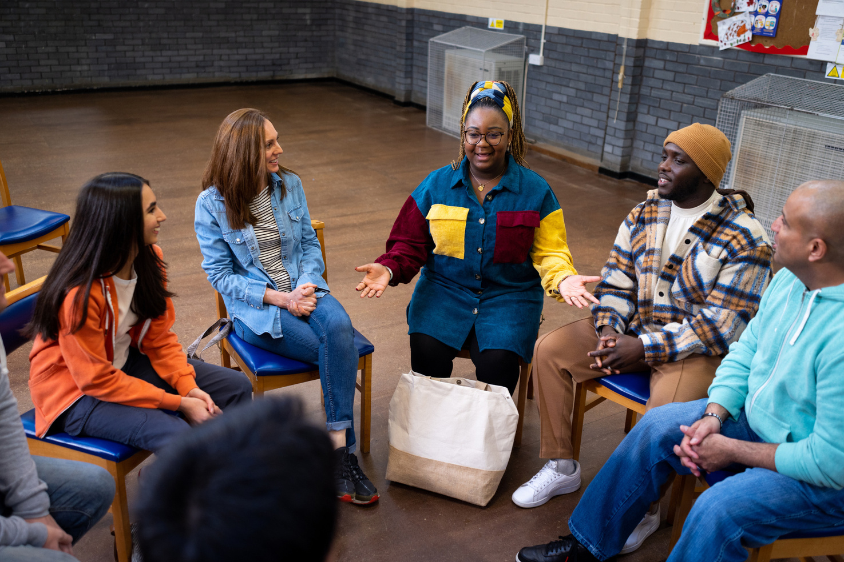
Core Statutory Local
Healthwatch Functions
    Gathering experiences from patients & service users, their carers and the public; to make recommendations to commissioners/providers as to the improvement of services
    Provide advice & information [‘Signposting’] as to how and where services can be accessed.
    Monitoring the quality of health and social care services - including private and voluntary / community sectors where contracted to deliver publicly funded health and care services

Slide 7

Update on our current projects
with
Senior Engagement Officers
Suzy James and
Margaret Reilly

Slide 8

Community Mental Health Services
with Senior Engagement Officer Suzy James
  Project Background
  Aims
  Approach
  Timescales
  Strategic and Operational links with Mental Health services in Worcestershire

Slide 9

Adult Front Door (AFD)
with Senior Engagement Officer Margaret Reilly
  Gateway to Adult Social Care Services in Worcestershire
  Observation (11) & Telephone Interviews (13)
(24 total)
  Good Practice & Learning:
  Contacting the Front Door
  Getting a Response
  Talking with the Advisor
  Outcome from the contact
  Recommendations & Considerations
  Next Steps

Slide 10

Themes underpinning our work
  Health Inequalities
  Carers
  Equalities Characteristics
  Accessible Information

Slide 11
Examples Of Our Current Project Work
  Primary Care - Public Health Messaging, access to GPs and Community Pharmacy
  Patient Access To PSA Testing through their GP
  Continuing Healthcare (CHC) Funding
  Sensory Impairment
  Improving Access to Dentists
  Care Homes/ Domiciliary Care
  Hospital Discharge
  Virtual Wards/Care at Home
  Neurological Disorders e.g. Parkinsons
  Learning Disabilities and Autism
  Gender Identity
  Children and Young People

Slide 12
Examples of Quality and Safety Monitoring
  ICS Elective Care Diagnostics and Cancer Board
  ICS Stroke Programme Board
  WAHT Quality Governance Committee
  WAHT Patient/Carer Public Experience Steering Group
  ICB Local maternity and neonatal system
  Worcestershire County Council Autism Partnership Board
  ICB Learning Disabilities and Autism Programme Board
  SEND & Alternative Provision Executive Board
  ICB Health Inequalities and Prevention Partnership
  Health and Wellbeing Board
  Health Overview and Scrutiny Committee
  Joint Strategic Needs Analysis

Slide 13

Making Sure People are Involved in Planning and Reviewing Services
    Ensuring our work programme is relevant
    Our reports and recommendations to improve services
    The experiences that patients, service users and carers’ share with us
    Providing advice and support to NHS/County Council in their statutory responsibilities to involve patients and service users in the design and delivery of services
    Promoting co-production, and holding the NHS and County Council to account on behalf of the public for the duty to involve
    Participating as a non-voting attendee within the meetings of Worcestershire’s Integrated Care Board
    Statutory Membership of the Health and Wellbeing Board

Slide 14
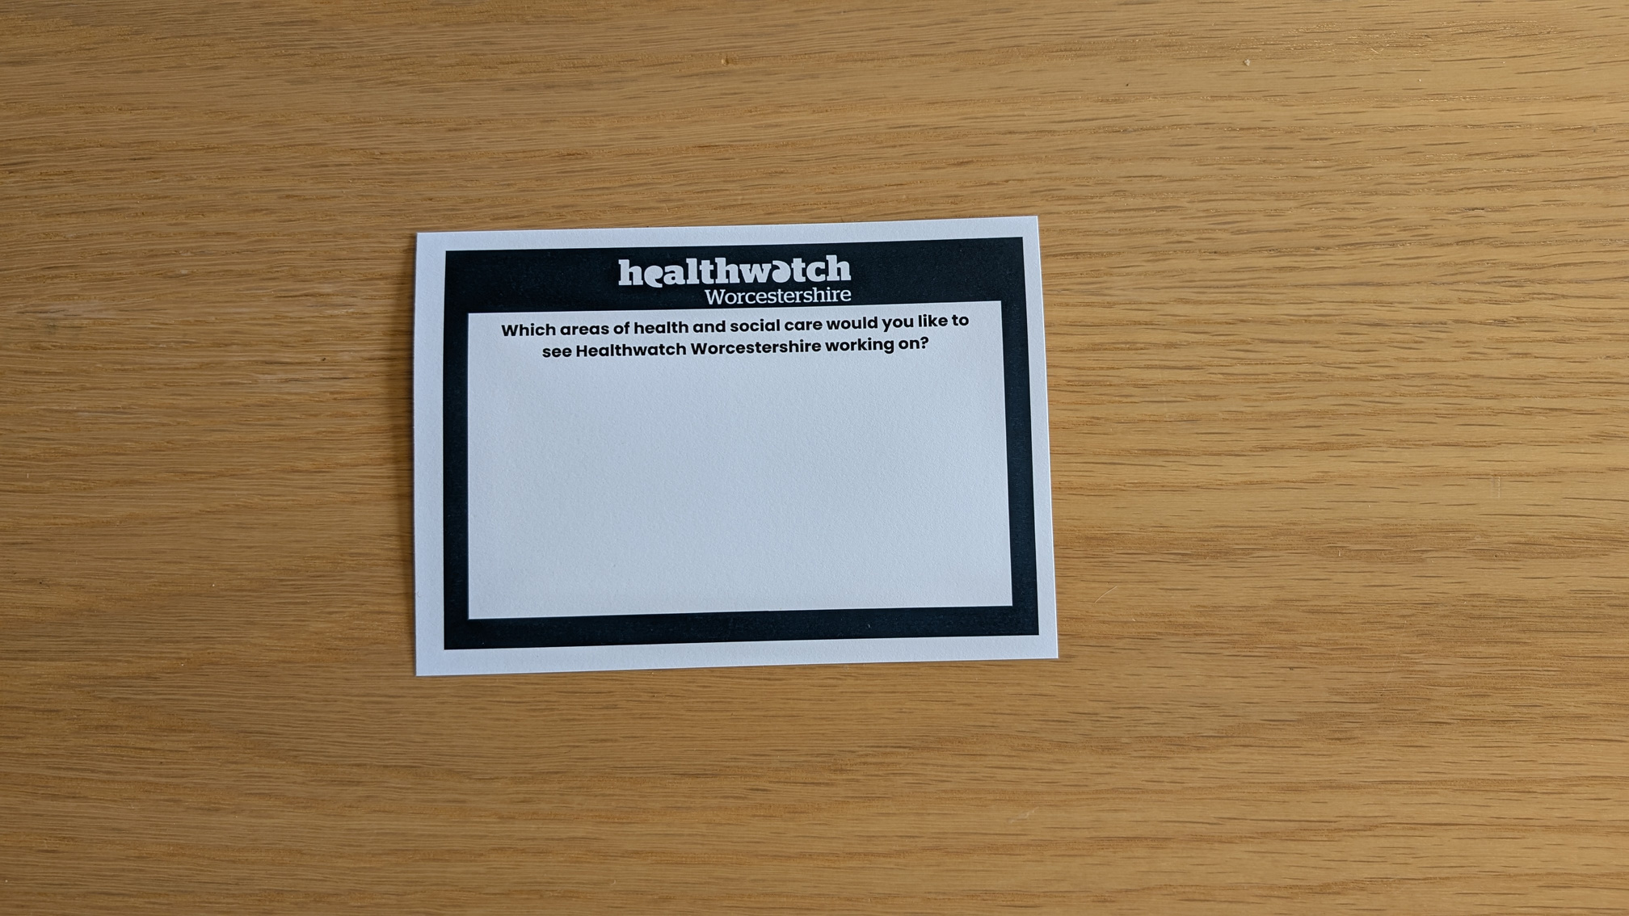
Have Your Say Activity
  There are blue cards and pens on your table.
  Write your opinions/thoughts about which areas of health and social care you would like to see Healthwatch Worcestershire working on
  Feel free to get a coffee during the session
  Put your questions for Dr. Kathryn Cobain into the postbox by 11:30

Slide 15



Have Your Say
Final Thoughts

Slide 16

Project Updates
Hospital Discharge with
Melanie Dawson, Chair of the Registered Managers Network
Margaret Reilly, Senior Engagement Officer, Healthwatch Worcestershire

Slide 17
HOSPITAL DISCHARGE
  HWW Report - Hospital Discharge During Covid 19 – Aug 2021
  Acute Trust – Inpatient Discharge Policy – Outstanding Issues incl. Discharge Checklist
  Acute Trust – May 2024 – Follow Up
  Registered Managers Network – over to Melanie Dawson
  Working Group – Discharge Checklist, dialogue, system approach

Slide 18
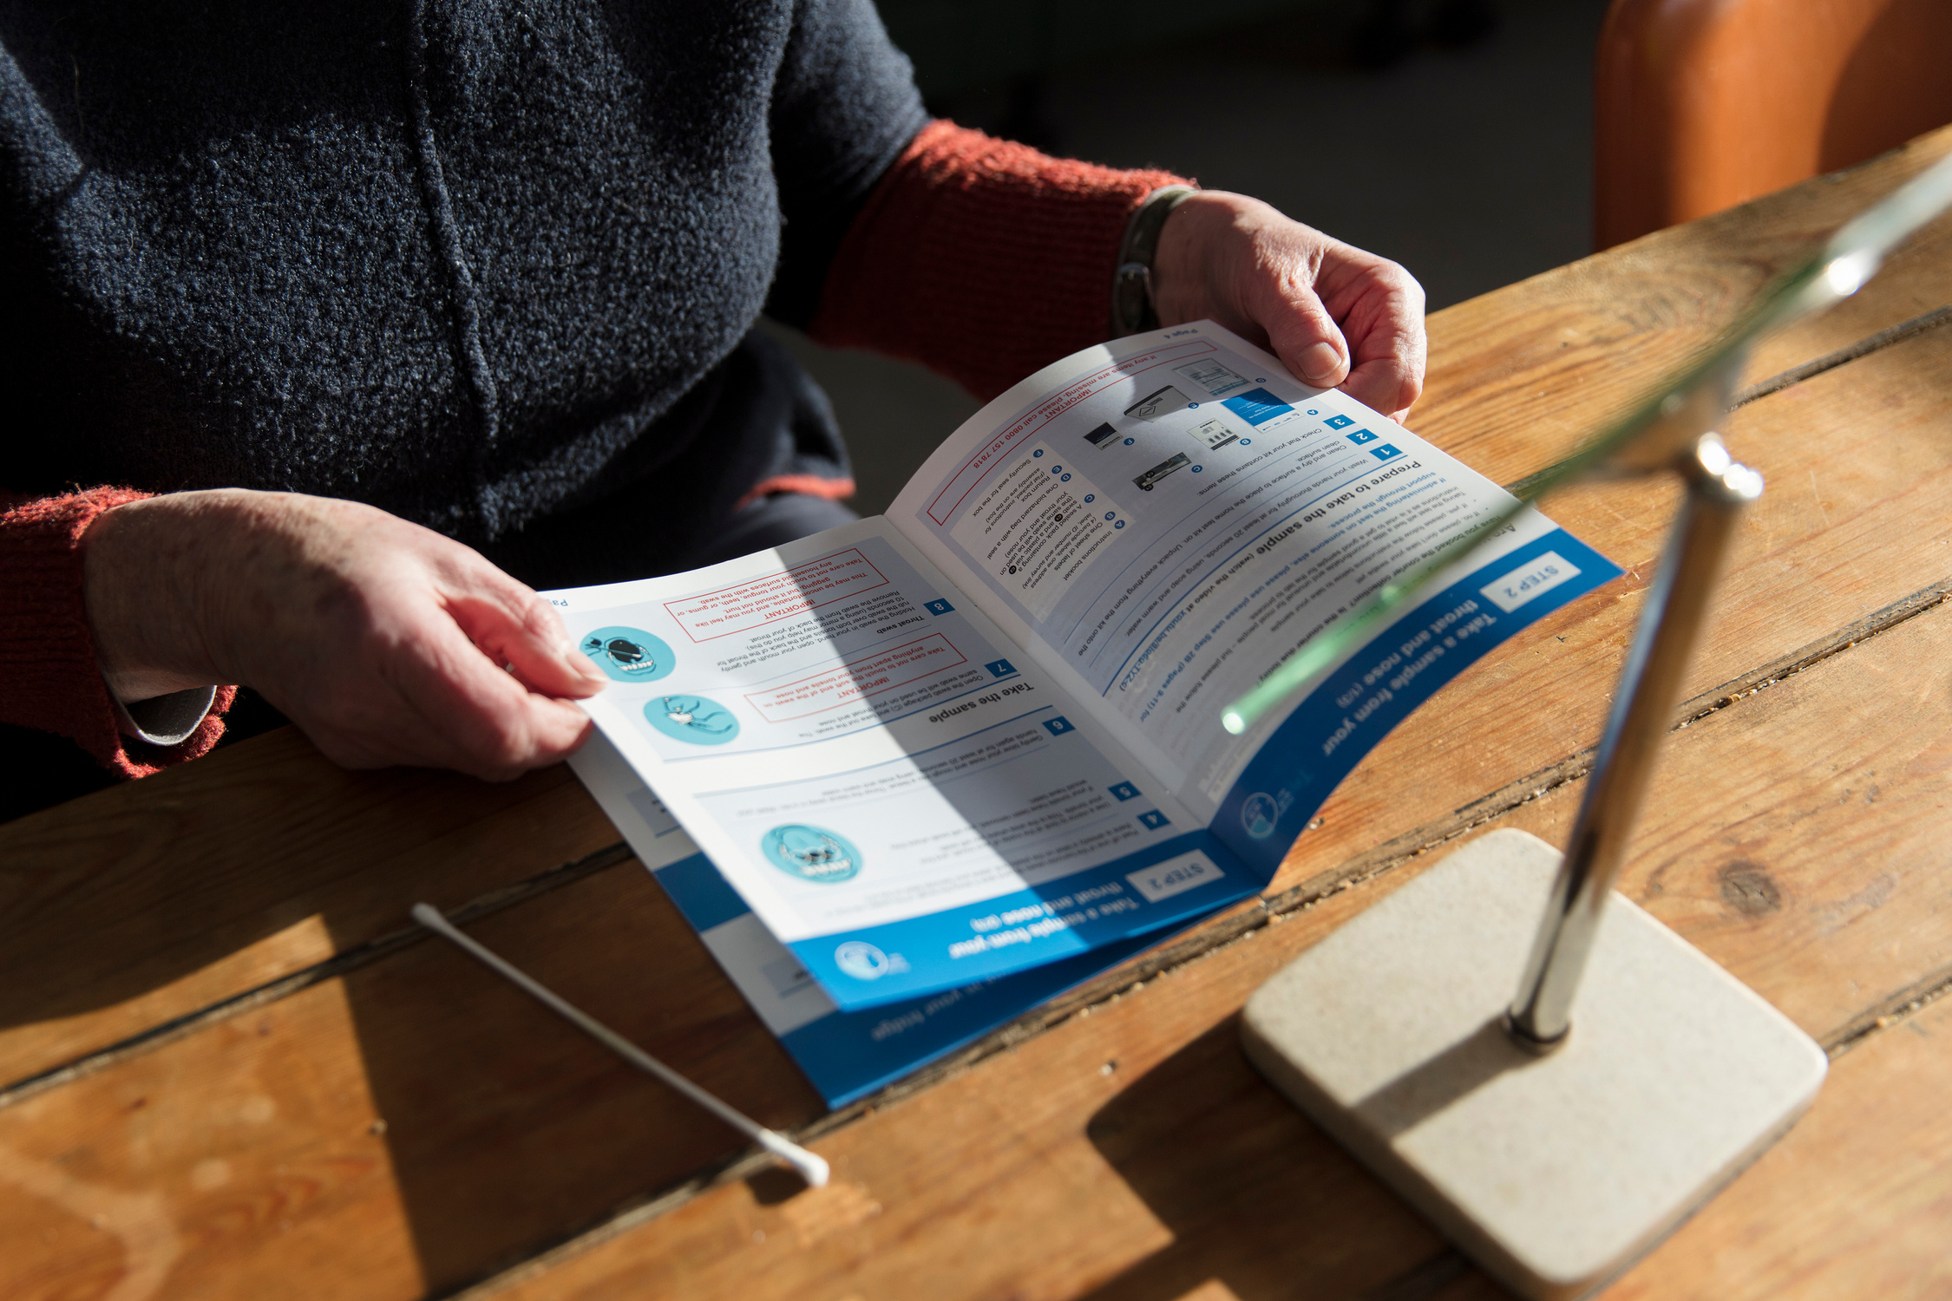
Project Updates
Accessible Information Standard
Don Beckett, Director, Healthwatch Worcestershire

Slide 19
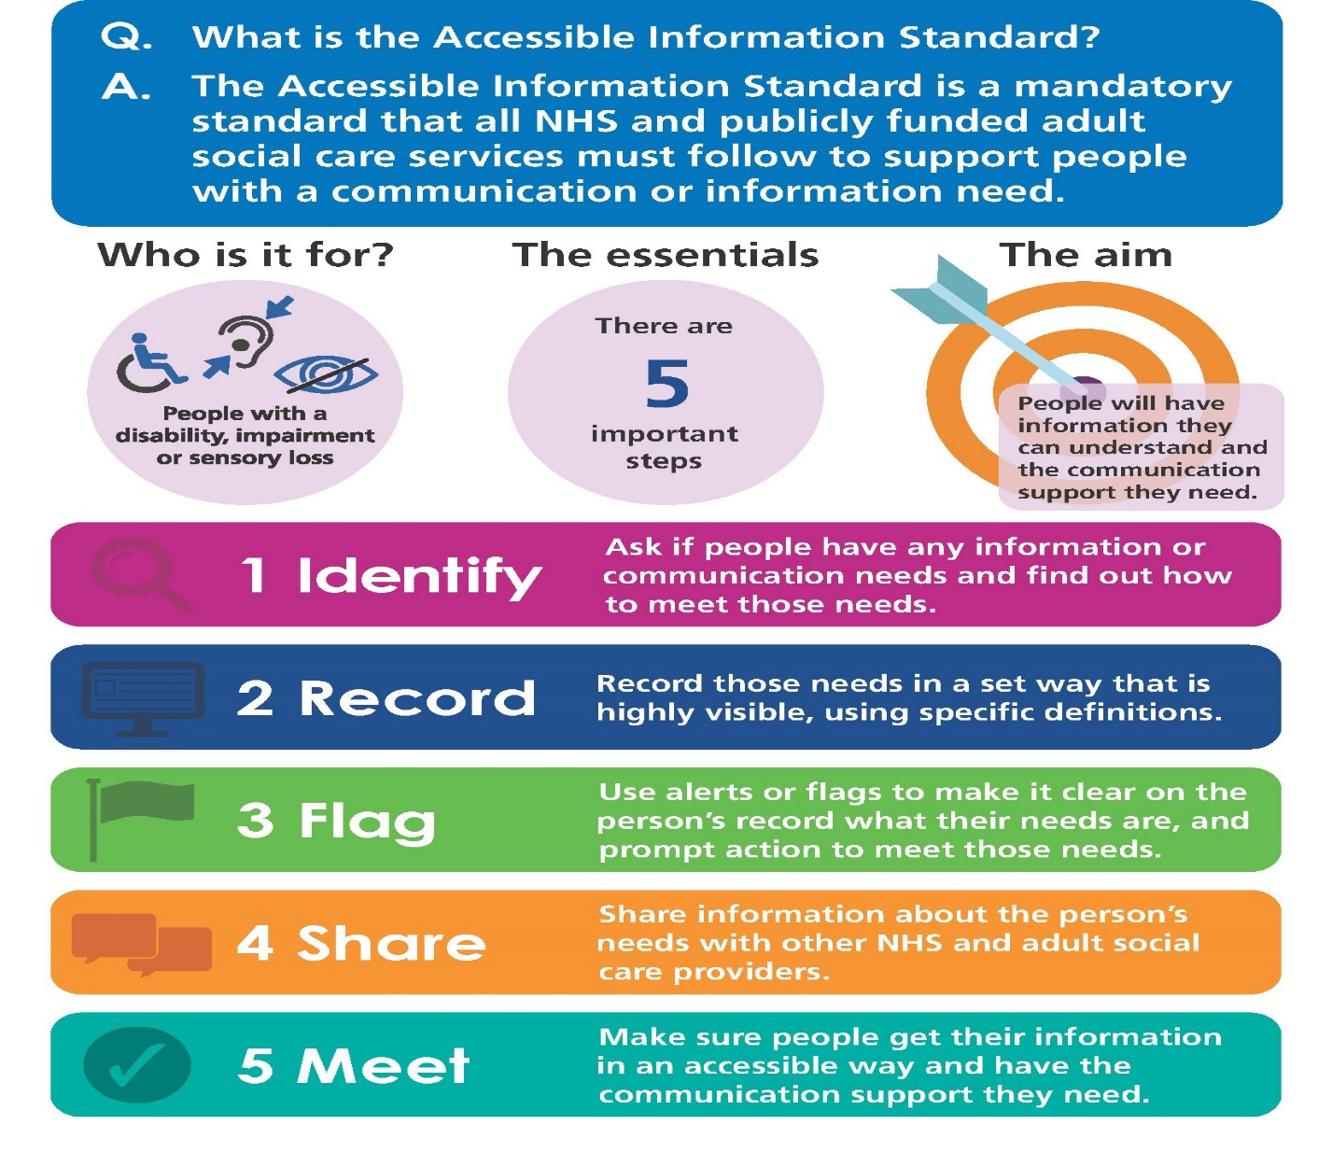
Accessible Information Standard (AIS)
AIS

Slide 20
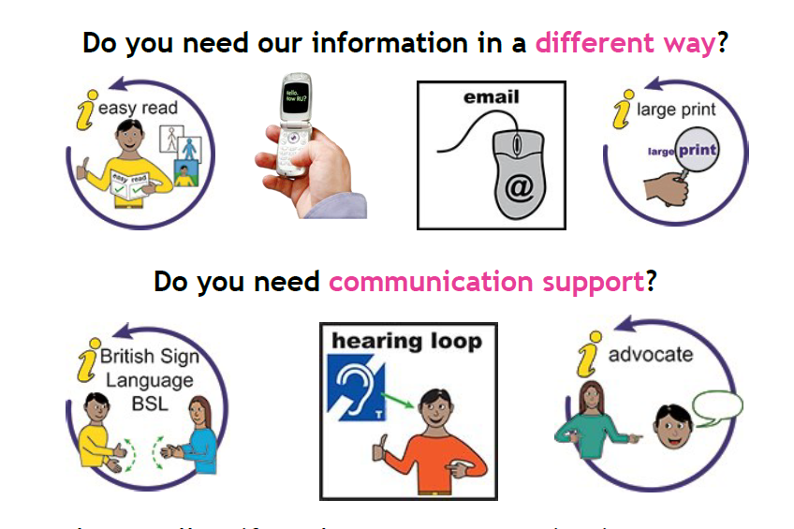
AIS- a MANDATORY standard
AIS

Slide 21
HWW engagement with people with sensory impairments – a health inequality issue
  Don’t know what AIS is
  Not always asked about information/communication needs
  It’s hit and miss - needs are not consistently met, even when known
  Not all have access to smartphone or web tech, those who have it can’t always use it, some don’t want to use it
  Online info from credible sources & accessible (easy read versions, screen reader ready, expandable [NHS Apple app], BSL video/relay)
  BSL Interpreters - not sure IF they have been booked; not sure IF they will turn up; not sure IF they will understand the medical terminology involved

Slide 22


John Irvine
Healthwatch Worcestershire Volunteer
Experience of using NHS Services
AIS

Slide 23
HWW engagement with people with sensory impairments – a health inequality issue
  Can build in delay – waiting for alternative formats / interpreter booking
  Builds in stress – will I be able to understand the letter, person, discussion?
  Privacy & Confidentiality – should not have to ask others (read letters, interpret etc.)
  Patient safety – can people understand their medication, diagnosis, options and treatment
  Impacts on people’s ability to be in control of their own health
  Staff awareness – not always sensitive to needs of people with SI

Slide 24
What We Did
  HWW recognise issues are cross cutting & require system wide ownership
  Wrote in Jan 2024 to ICB asking for clarity re governance and oversight ref sensory impairment, and named responsible senior manager
  H&W NHS response - no single committee, board or person – system responsibility – requirements for Equality Impact Assessments to consider impacts
  HWW Report of Engagement with people with vision impairment – March 2024
  AIS still not working for people with VI
  Challenge to ICB from HWW and to HWW from partners

Slide 25
What We Did Continued...
Integrated Care System (ICS)
  Worcestershire Place Partnership (Jan 25) - Outcomes:
  Digital workstream – flags on the system
  Health Inequalities Ambassadors Invite
  Health Inequalities Ambassadors (March 25) – Outcomes:
David Mehaffey, Executive Director: Strategy, Health Inequalities and Integration – volunteered as SI lead for ICB
  Meeting with ICB (May 25) – Outcomes:
  Future iterations of ICB Equality Impact assessments will be updated to include a specific question about Sensory Impairment, also to be reflected in EIA guidance
  Half hour presentation to HI Ambassadors – expansion of evidence and clear asks of the Ambassadors
  HWW Working Group – 5th June
  H&W Health & Care Trust (Jan & May 25) – Outcomes:
  AIS Working Group to be established – links to Trust Health Literacy Work

Slide 26
Keynote Speakers
Presentation From:
Helen Harris, Associate Director of Nursing and Quality
Q&A with:
Dr. Kathryn Cobain, Chief Nursing Officer, Herefordshire and Worcestershire ICB

Slide 27

Lunch and Networking
14:15 - Public Board Meeting
Thank You For Attending

